Slide 1
Experiences in Managing the Performance and Reliability of a Large-Scale Genomics Cloud Platform
Reporter: 何孝发

Slide 2
Genomics Data Commons(GDC)
A genomics data processing cloud platform
Various pipelines
DNA-Seq Alignment
RNA-Seq Alignment
……
Hybrid cloud system
Private on-premise VM cloud
Powered by OpenStack/KVM
Ceph and Cleversafe for storage
Public AWS cloud

Slide 3
What we are to share…
Show how common bioinformatics workloads cause VMs to age
Show the root cause that degrades the pipeline performance on VMs
Share our technical experiences in improving the performance of long-running jobs on GDC
Notes:
初级课程的详细信息和/或课目/项目所需的书籍/资料。

Slide 4
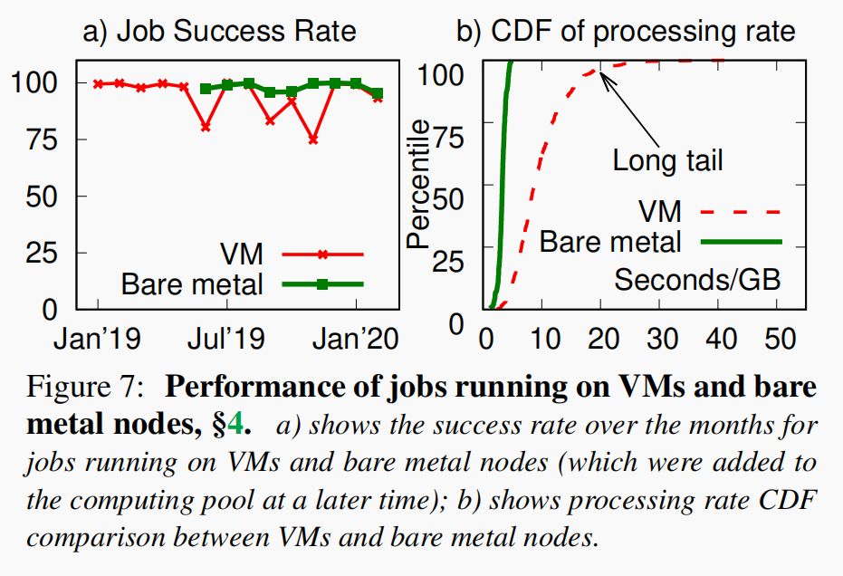
Problems we found
Long running pipelines performed better on bare metal nodes versus using VMs
Job Success Rate = (successful jobs) / (total job)
Processing rate = (job execution time) / (input data size)

Slide 5
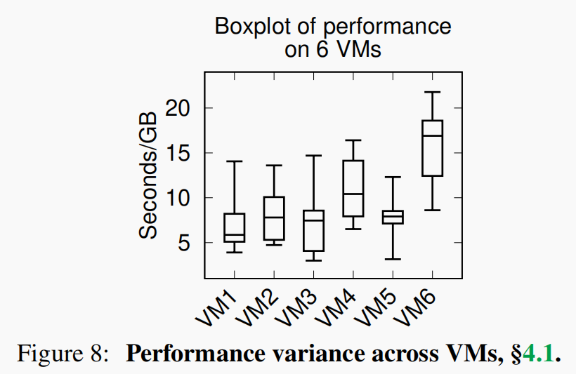
Eliminating hardware degradation
Take six VMs that run on six different machines
VM1 on machine1
……
Run the same job pipeline repeatedly on every VM

Slide 6
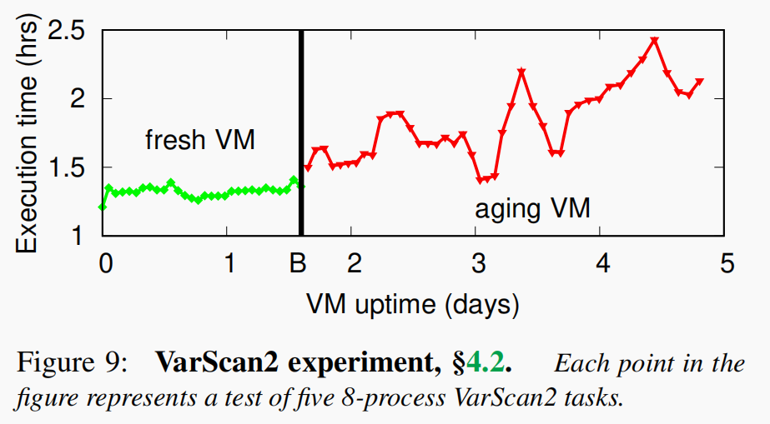
Application-level Measurement
Problem we found jobs started running slower on VMs after several days
Experiments we conducted:
1) One cold-restarted VM as a Fresh VM
2) Five old VMs that’s been running for days
3) The same configuration, run the same job pipeline

Slide 7
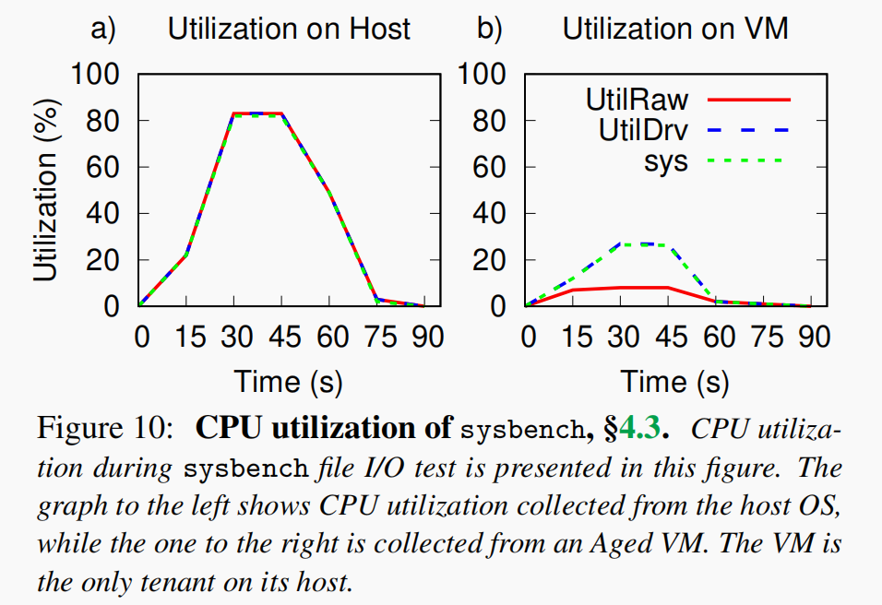
Kernel-Level Measurement
Tools that profile CPU utilization
top
scollector
We use scollector

Slide 8
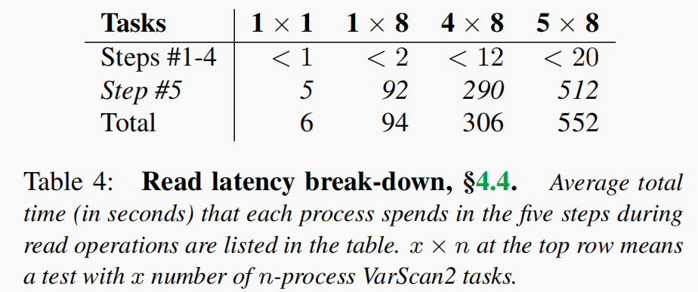
Memory fragmentation
File read operation in five steps:
1) Check the page cache
2) Conduct synchronized read request at the FS
3) Send out asynchronized read request at the block
4) Wait for completion
5) Copy the data from the kernel to the user space

Slide 9
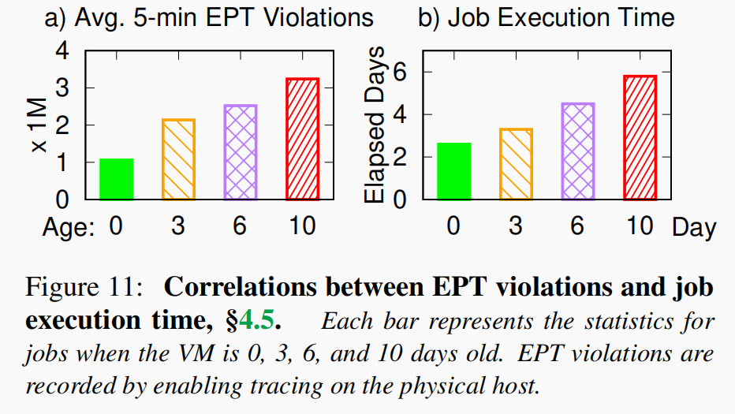
Root cause: EPT violation
EPT table
Serves as a page table that stores the mapping between the VM memory physical address and the host physical address
Whenever there is a TLB miss, an EPT violation occurs
Conclusion
VM aging leads to more frequent EPT violations causing the hypervisor to interrupt the VM more frequently

Slide 10
Mitigations
Using huge pages
Restarting VM
Defragmenting memory
Running on bare metal
Using public clouds

Slide 11
